Slide 1
Text Types
by María José Verdugo Vilches
Course: Discourse Analysis
Prof. Héctor Vega P.

Slide 2
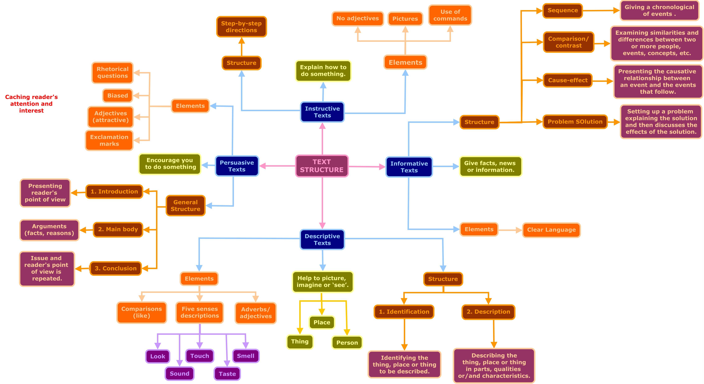

Slide 3
REFERENCES
Droga, L., & Humphrey, S. (2003). Grammar and meaning: An introduction for primary teachers. New South Wales,, Australia: Target Texts. Retrieved from https://goo.gl/pAQCUy
Skillswise. (2011). Understanding different types of text. BBC. Retrieved from https://goo.gl/aoJFCh
AdLit. (2017). Text Structure. Retrieved from http://www.adlit.org/strategies/23336/

