Slide 1
Text & Discourse
Student: María José Verdugo
Course: Discourse Analysis
Instructor: Héctor Vega P.

Slide 2
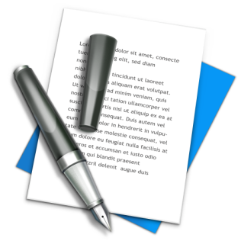
Language
Spoken
Written
The speaker can use a full range of paralinguistic cues.
There are no paralinguistic features for the writer to use
Facial expressions
Gestures and postural systems
The writer may look over his work, make pauses and corrections.
The speaker controls and processes the language during the exact moment of production.
Brown, G & Yule, G. (1983)

Slide 3
Discourse
Set of utterances which are connected
by several relations.
It needs
a context
One speaker
Two or more
speakers
Situation
of production
Deictic anchoring
Conversation
Pragmatics
It defines discourse as the moment of speaking “here and now”.
**Discourse vanishes the moment it is produced.
Haberland, H. (1999)

Slide 4
Text
Discourse taken out of its immediate context.
Writtings
Recordings
Transporable
Reported Speech
Quotations
Space
Texts help to preserve traditions and cultures.
Time
**Some authors claim that it is possible to do pragmatics to a text, by describing and giving the context or situation where the discourse occurred in the past.
Haberland, H. (1999)

Slide 5
Discourse precedes the text, and discourse can stem from texts since they are as divergent as necessary to one onether.
Haberland, H. (1999)

Slide 6
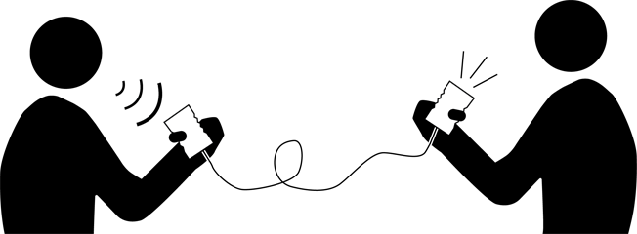
Analysis of discourse
Analysis of language in use.
What language is used for.
There are two main terms for describing the functions of language.
Transactional View
Interactional View
Delivery of information
Social relations
Brown, G & Yule, G. (1983)

Slide 7
REFERENCES
Brown, G. & Yule, G. (1983). Linguistic Forms and Functions. Discourse analysis. Cambridge University Press.
Haberland, H. (1999). Text, discourse, discours: The latest report from the Terminology Vice Squad. Journal of pragmatics, 31(7), 911-918.

